Slide 1
Rice Magician

Slide 2
Did you find out what the staple food is?
They are made of rice.

Slide 3
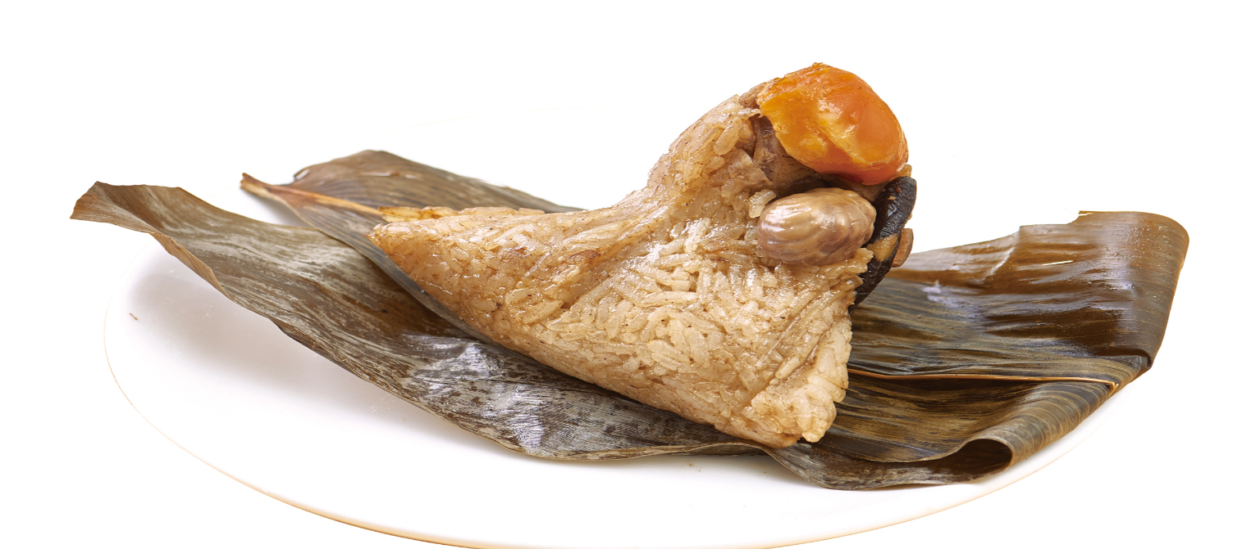
It’s made of rice.
Rice dumplings

Slide 4
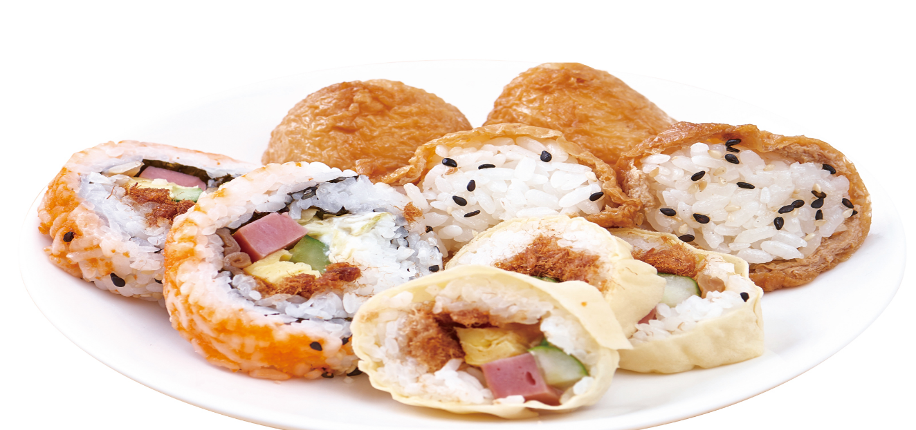
It’s made of rice.
Sushi

Slide 5
It’s made of rice.
Puffed rice cakes

Slide 6
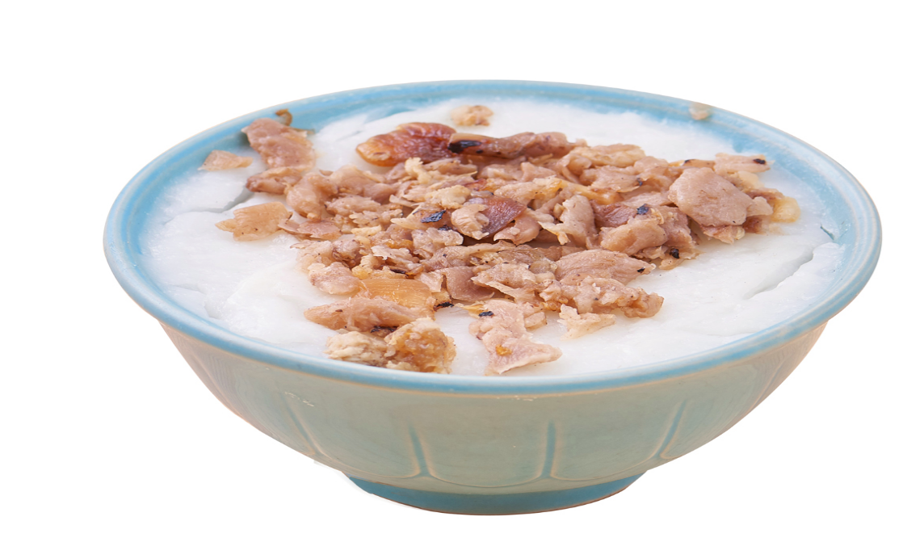
It’s made of rice.
Rice cakes

Slide 7
It’s made of rice.
Rice crackers

Slide 8
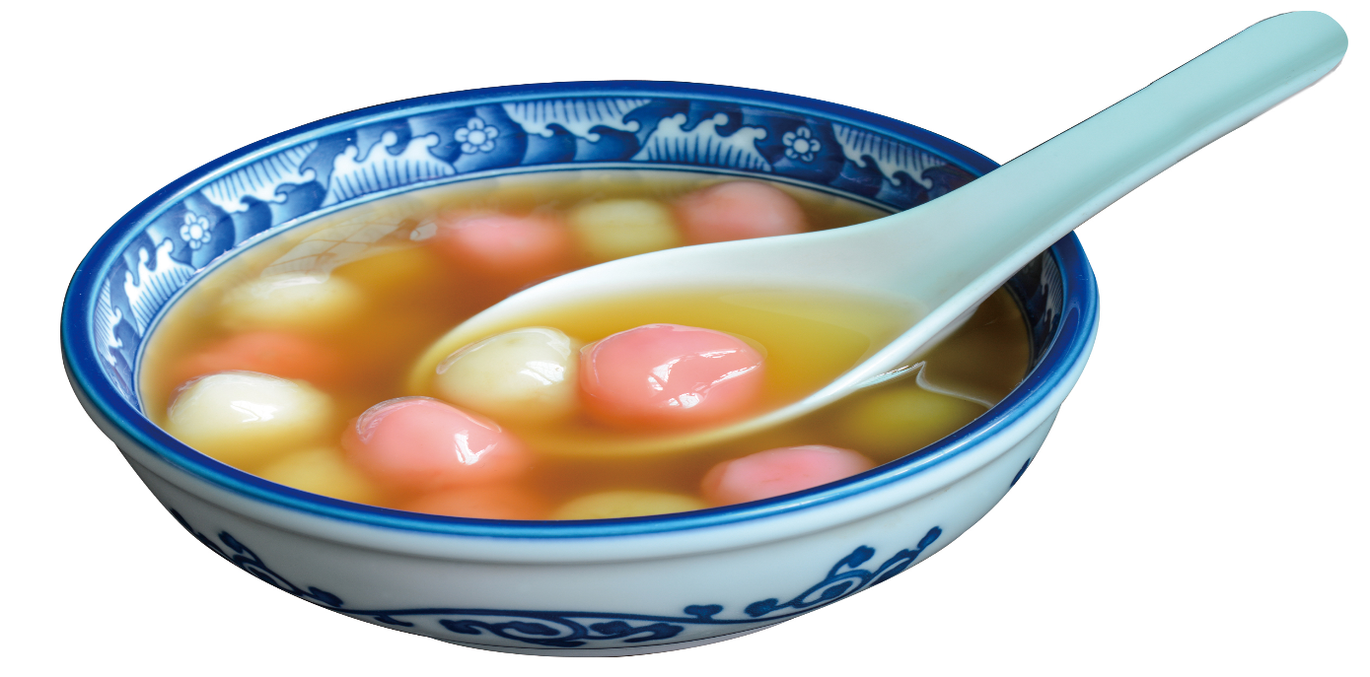
It’s made of rice.
Rice balls

Slide 9
It’s made of rice.
Radish cake

Slide 10
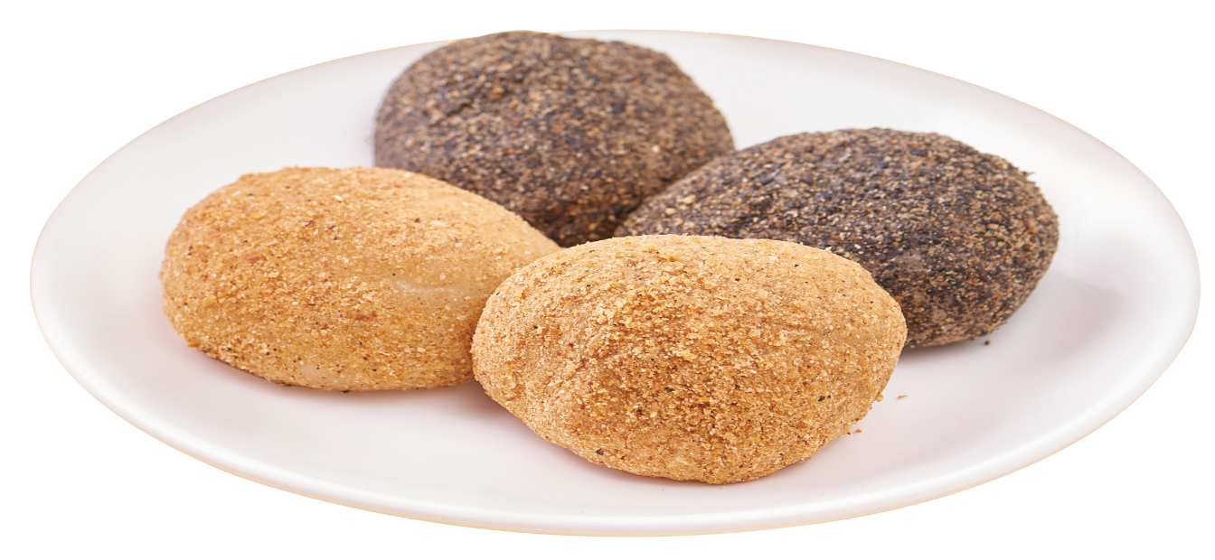
It’s made of rice.
Mochi

Slide 11
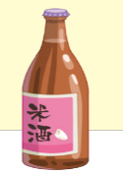
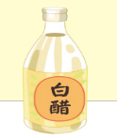
Magic rice product
rice grains
white vinegar

Slide 12
DIY Paper sushi

Slide 13
DIY Paper sushi

Slide 14
Internationsal food
rice paper
Vietnamese spring rolls

Slide 15
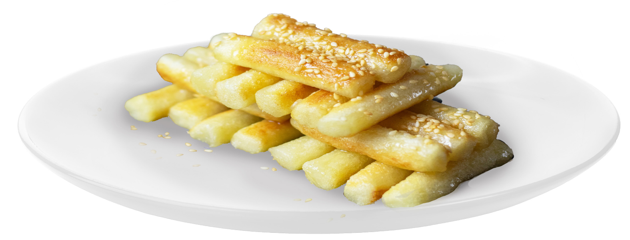
Internationsal food
Korean rice cake

Slide 16
Internationsal food
Japan sushi

Slide 17
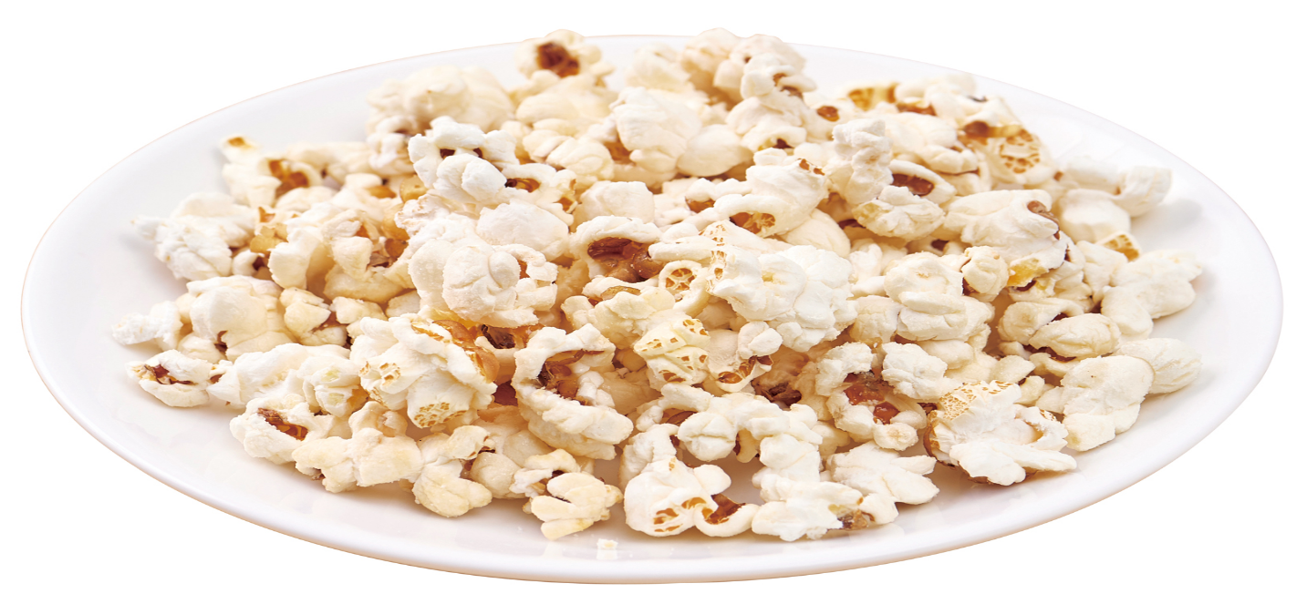
Popcorn is not made of rice.

Slide 18
Farmer hard work.

Slide 19
Oats, Peas, Beans, and Barley Grow
https://youtu.be/8GvOV5QO0tg

Slide 20
Draw a poster

