Slide 1
Light&Shadow

Slide 2
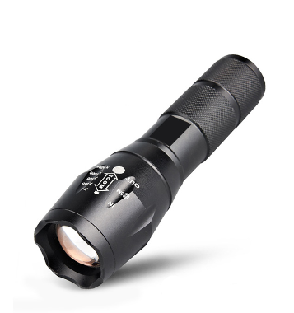
Light
Sun
Flashlight

Slide 3
Shadow
Shadow

Slide 4
Where is the light?
Shadow

Slide 5
Where is the light?

Slide 6
Where is the light?
Sun

Slide 7
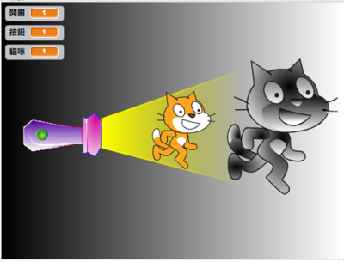
Where is the light?
Shadow

Slide 8
Where is the light?
flashlight

Slide 9
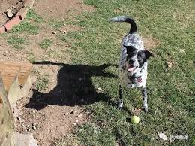
Where is the Shadow?
Sun

Slide 10
Where is the Shadow ?
Shadow

Slide 11
Finish the worksheet

