Slide 1
新化美食地圖

Slide 2
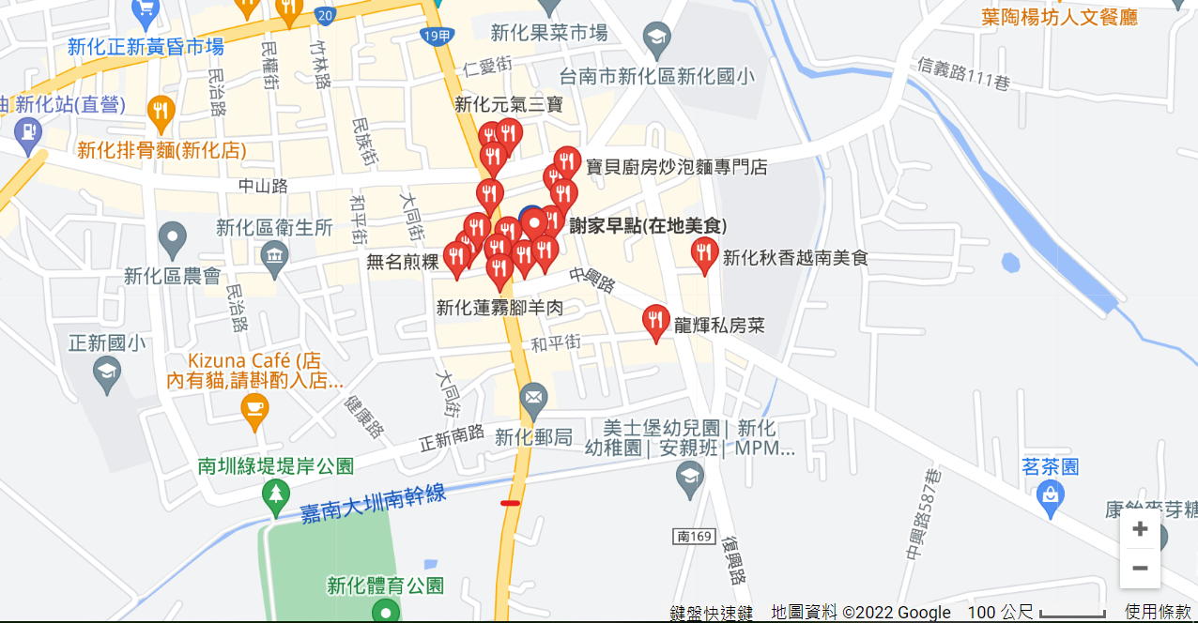
Instructions for use
EDIT IN GOOGLE SLIDES
Click on the button under the presentation preview that says "Use as Google Slides Theme".
You will get a copy of this document on your Google Drive and will be able to edit, add or delete slides.
You have to be signed in to your Google account.
EDIT IN POWERPOINT®
Click on the button under the presentation preview that says "Download as PowerPoint template". You will get a .pptx file that you can edit in PowerPoint.
Remember to download and install the fonts used in this presentation (you’ll find the links to the font files needed in the Presentation design slide)
More info on how to use this template at slidescarnival.com/help-use-presentation-template
This template is free to use under Creative Commons Attribution license. You can keep the Credits slide or mention SlidesCarnival and other resources used in a slide footer.

Slide 3
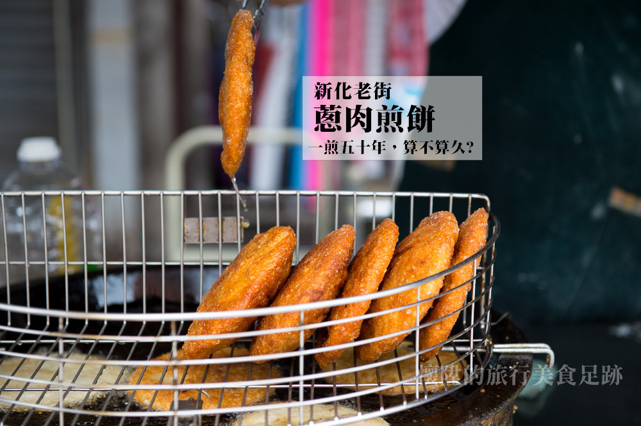
上海老爹蔥肉煎餅
1.台南新化老街上,有一間50多年的蔥肉餅老店,是陪伴許多新化居民一起長大的好味道。
2.我覺得蔥肉餅的肉香味四溢，蔥和餅的搭配只能說一絕。

Slide 4
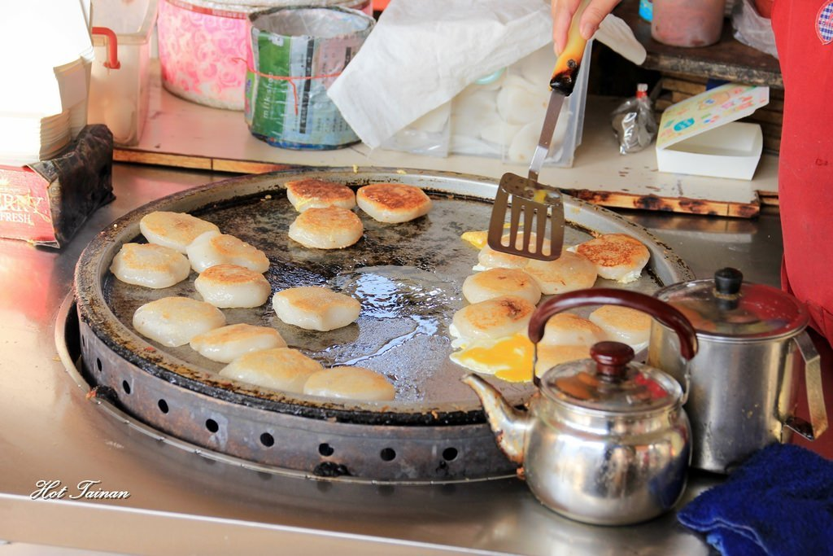
無名肉粿
1.只要來到新化，這家市場口的肉粿攤就一定不能錯過！除非是他沒開，不然來新化不吃它，真的太對不起自己的胃了啦~
2.它的肉粿真的是我吃過最好吃的肉粿，以前我放學爸爸都會帶我去吃，外蘇里嫩，每次吃都不會膩!

Slide 5
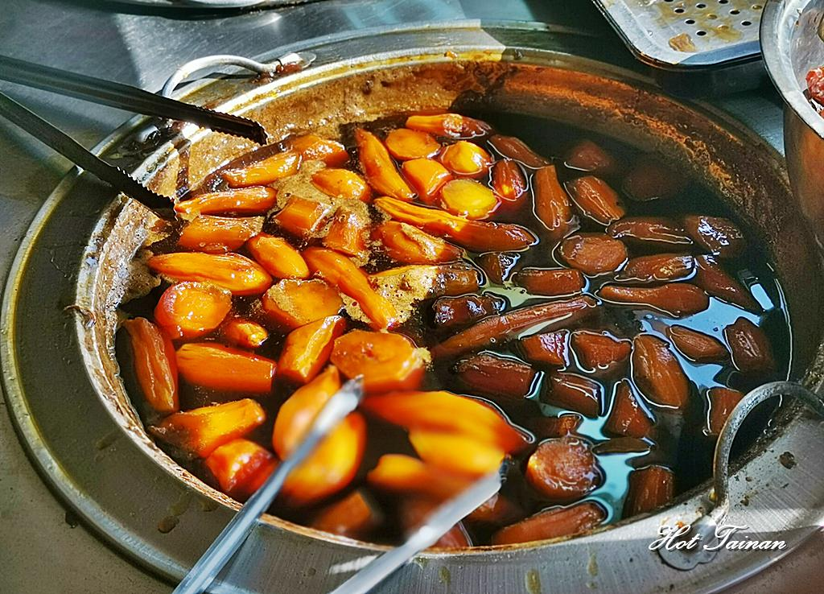
新化古早味番薯糖
1.新化是盛產番薯的寶地，聽新化當地人說新化伴手禮要買番薯明的番薯餅，如果是甜點的話就一定要來這間新化護安宮對面的番薯糖就對了！這家可是在地超過50年的老店，冬天賣番薯糖及烤地瓜，夏天還有古早味黑糖挫冰喔！
2.這家番薯糖是我個人比較喜歡的，因為我覺得不會太甜，而且服務的很貼心，所以我很喜歡!

