Slide 1
新化美食地圖

Slide 2
Instructions for use
EDIT IN GOOGLE SLIDES
Click on the button under the presentation preview that says "Use as Google Slides Theme".
You will get a copy of this document on your Google Drive and will be able to edit, add or delete slides.
You have to be signed in to your Google account.
EDIT IN POWERPOINT®
Click on the button under the presentation preview that says "Download as PowerPoint template". You will get a .pptx file that you can edit in PowerPoint.
Remember to download and install the fonts used in this presentation (you’ll find the links to the font files needed in the Presentation design slide)
More info on how to use this template at slidescarnival.com/help-use-presentation-template
This template is free to use under Creative Commons Attribution license. You can keep the Credits slide or mention SlidesCarnival and other resources used in a slide footer.

Slide 3
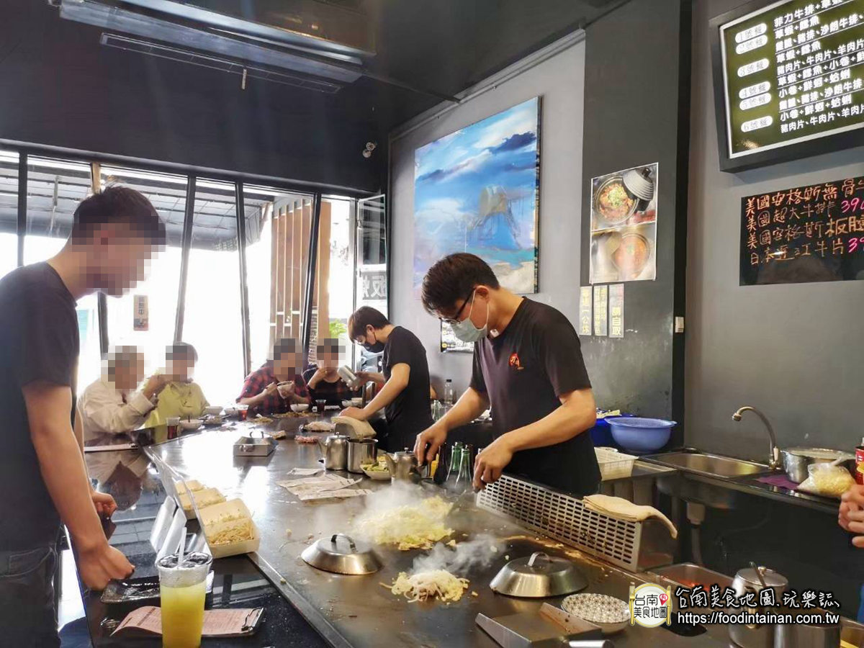
力都鐵板燒
1.力都鐵板燒位在新化老街古蹟街役場旁邊，原本店址在老
街上，近幾年遷址到這，停車也更方便了許多
2.雞腿、豬排、沙朗牛排、三層肉(擇一)+草蝦+鱈魚的力都A餐，搭配兩樣青菜和白飯，一份只要$240元編編覺得價格很OK~
照片來源:
https://decing.tw/tainan-lidoshinha/

Slide 4
新化市場口阿婆雞蛋糕

