Slide 1


Slide 2
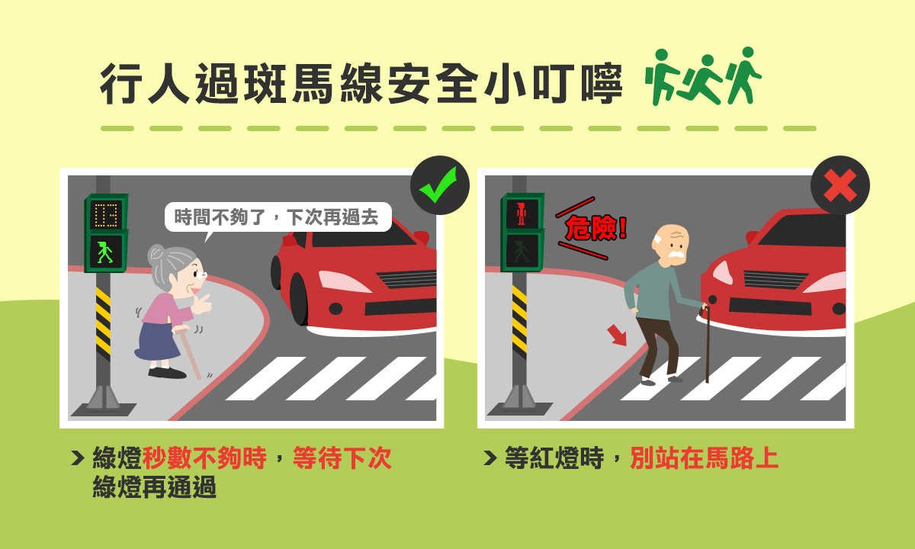

Slide 3
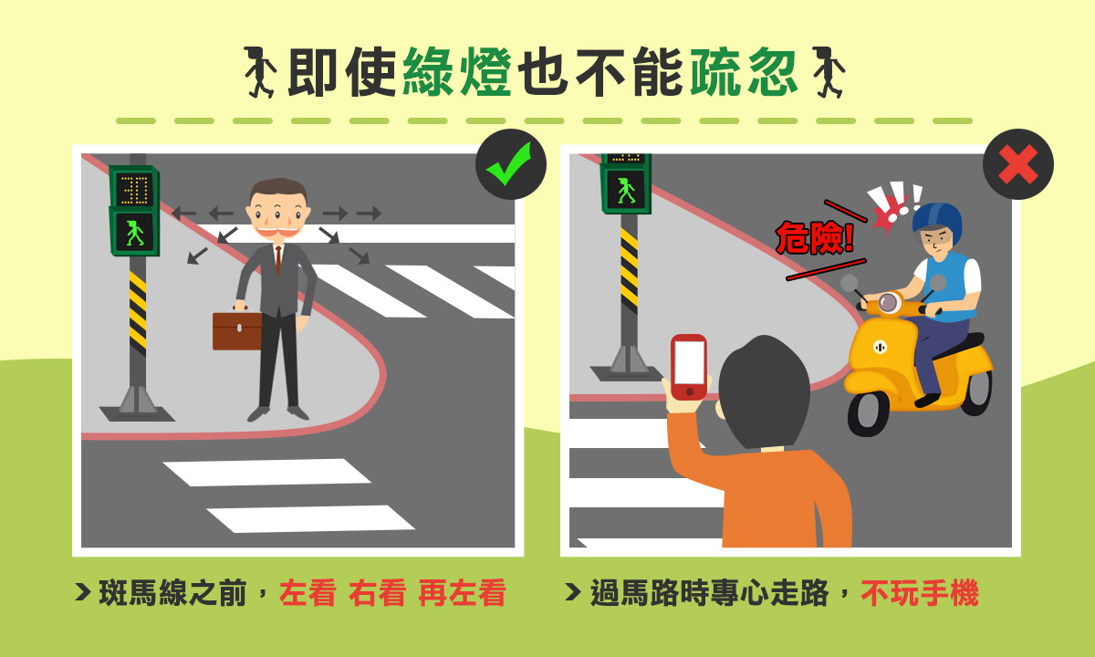

Slide 4
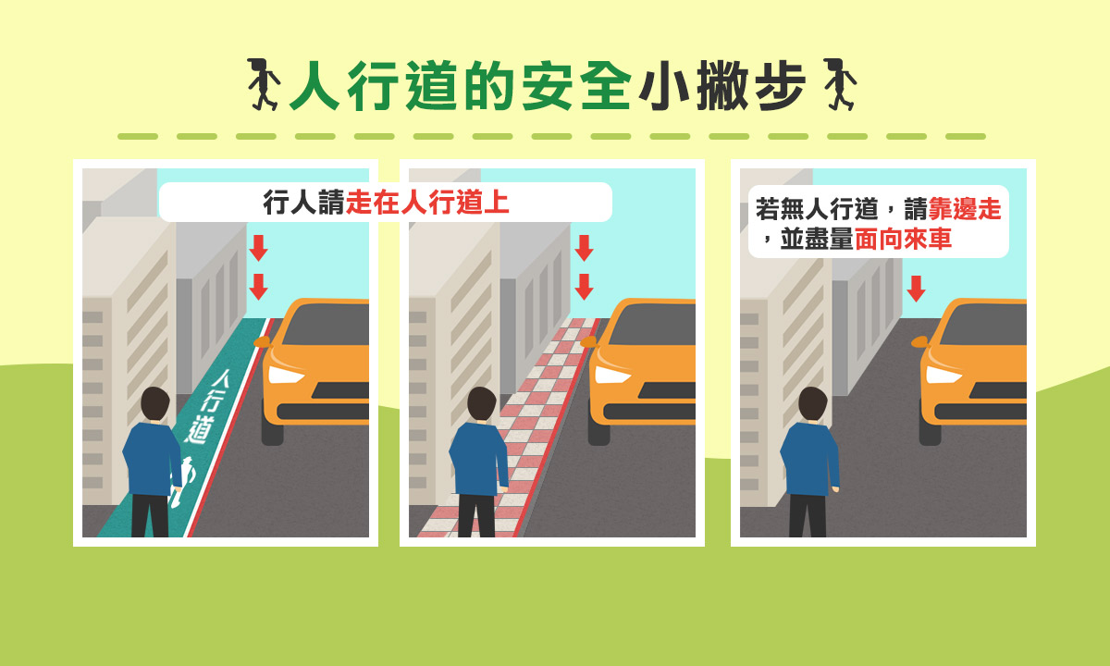

Slide 5
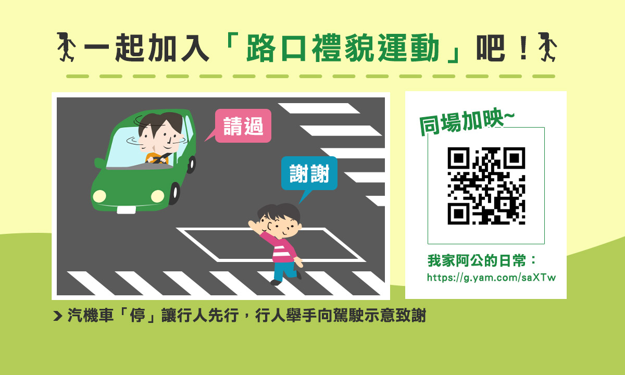

Slide 6


Slide 7
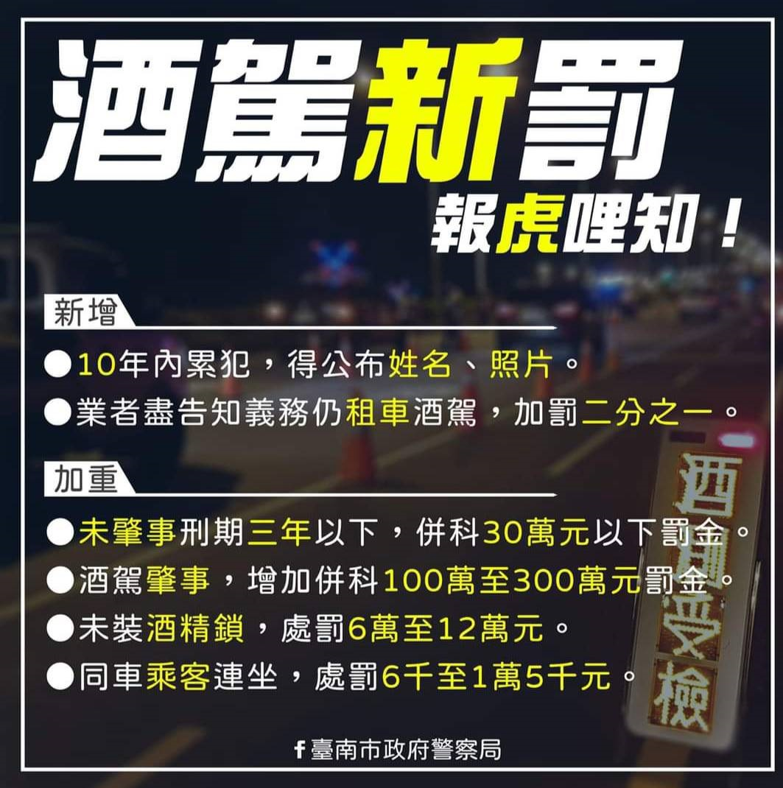

Slide 8


Slide 9

https://168.motc.gov.tw/theme/video/post/1906121100038

