Slide 1
Getting to Know Each Other
Notes:
Hi, I’m Vivian. I’m from Dajia elementary school.

Slide 2
Bingo
Do you like to swim?
What color do you like?
What do you like to eat?
What subjects do you like?
What sports do you like?
What’s your favorite season?
What do you like to do on Sundays?
What's something you do well?
Where are you going after this workshop?
Do you have pets?
What do you do in your free time?
How do you get to school each day?
What languages do you speak?
What makes you happy?
Have you every prepare lessons with others?
What was the last book you read?
1 | 2 | 3 | 4
5 | 6 | 7 | 8
9 | 10 | 11 | 12
13 | 14 | 15 | 16

Slide 3
Classroom Language in English
Procedural Language
Functional Language
Target Language

Slide 4
Procedural language | Functional language | Target language
used by the teacher to set up the activity | needed by the students to complete the activity | Sentence Patter / Vocabulary
*Ask high level Ss to model the game rules *not just ask Ss ‘Do you understand’ ask Ss to say sth out | *teach Ss before the task/activity *allow Ss to speak Chinese at the beginning, then no point with Chinese, double the point with all English *Make your own classroom functional language card | Sometimes the target language is the least part.

Slide 5
Procedural language
Functional Language
Write your name / school here.
Put your paper in the bag.
Ask one person one question.
Then, ask another person.
I’m going to draw a name from the bag.
If the name is on your sheet, mark it and stand up.
Say something about the person.
Come here.
Draw another name.
Once your marks can be a line, either vertical, horizontal, or diagonal, yell BINGO.
Hi, My name is ______. / I’m ______.
Nice to talk to you. / Nice to talk to you, too.
I go first.
It’s my turn.
Please sign your name here.
Thank you.
What does … mean?
How do you say … in English?
How do you spell ______?
Can you repeat please.
Can you help me, please?
I’ve finished / done this.

Slide 6
Differentiation in the Mixed Ability Classroom

Slide 7
Fair isn’t always equal.

Slide 8
One size doesn’t fit all.

Slide 9
差異化的各種面貌
Teachers can differentiate…
Content
Process
Product
Environment
According to Student’s
Readiness
Interest
Learning Profile

Slide 10
Content
Using reading materials at varying readability levels;
Putting text materials on tape;
Using spelling or vocabulary lists at readiness levels of students;
Presenting ideas through both auditory and visual means;
Using reading buddies; and
Meeting with small groups to re-teach an idea or skill for struggling learners, or to extend the thinking or skills of advanced learners.
http://www.readingrockets.org/article/what-differentiated-instruction

Slide 11
Process
Using tiered activities through which all learners work with the same important understandings and skills, but proceed with different levels of support, challenge, or complexity;
Providing interest centers that encourage students to explore subsets of the class topic of particular interest to them;
Developing personal agendas (task lists written by the teacher and containing both in-common work for the whole class and work that addresses individual needs of learners) to be completed either during specified agenda time or as students complete other work early;
Offering manipulatives or other hands-on supports for students who need them; and
Varying the length of time a student may take to complete a task in order to provide additional support for a struggling learner or to encourage an advanced learner to pursue a topic in greater depth.
http://www.readingrockets.org/article/what-differentiated-instruction

Slide 12
Products
Giving students options of how to express required learning (e.g., create a puppet show, write a letter, or develop a mural with labels);
Using rubrics that match and extend students' varied skills levels;
Allowing students to work alone or in small groups on their products; and
Encouraging students to create their own product assignments as long as the assignments contain required elements.
http://www.readingrockets.org/article/what-differentiated-instruction

Slide 13
Learning environment
Making sure there are places in the room to work quietly and without distraction, as well as places that invite student collaboration;
Providing materials that reflect a variety of cultures and home settings;
Setting out clear guidelines for independent work that matches individual needs;
Developing routines that allow students to get help when teachers are busy with other students and cannot help them immediately; and
Helping students understand that some learners need to move around to learn, while others do better sitting quietly (Tomlinson, 1995, 1999; Winebrenner, 1992, 1996).
http://www.readingrockets.org/article/what-differentiated-instruction

Slide 15
任務: 念出課本Phonics Time的句子
Tasks:
1 sentence
2 sentences
3sentences
3+1
Grouping
Individual
Pairs
homogeneous
互學

Slide 16
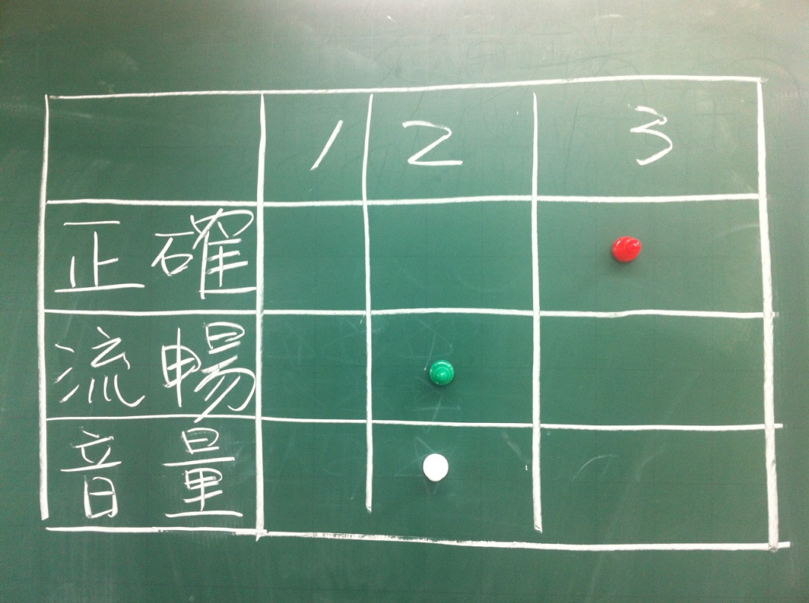
評量方式
上台表現
努力成績

Slide 17
任務:能進行簡易的角色扮演
Tasks:
RT
Role Play
Advanced Role Play
Grouping
heterogeneous

Slide 18
評量方式

