Slide 1
Today, we will be learning about…
Oyster Farming

Slide 2
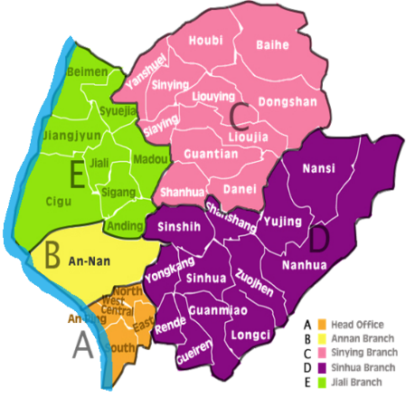
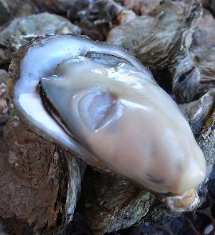
Where can we find oysters?
video time
All along the coast.
Notes:
source: 交通部觀光局雲嘉南濱海國家風景區管理處/鄧福隆

Slide 3
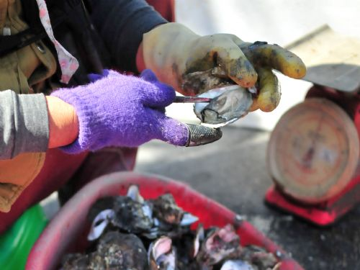
Oyster
This is an oyster.
Notes:
source: 交通部觀光局雲嘉南濱海國家風景區管理處/潘思祈

Slide 4
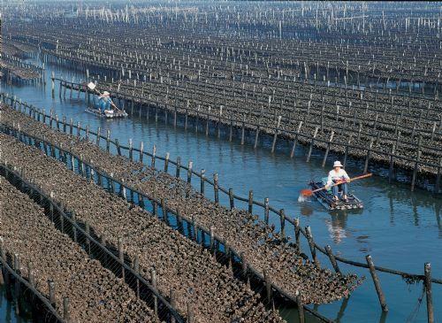
Oyster Beds
These are oyster beds.
Notes:
source: 交通部觀光局雲嘉南濱海國家風景區管理處/鄧福隆

Slide 5
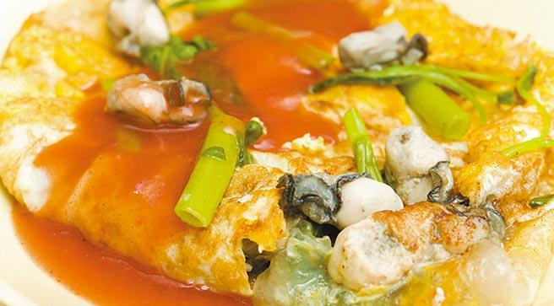
Oyster Omelet
This is an oyster omelet.

Slide 6
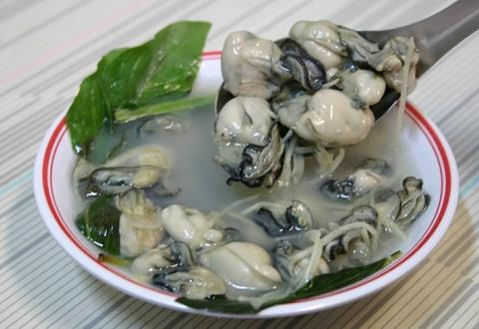
Oyster Soup
This is oyster soup.
http://tw.tranews.com/

Slide 7
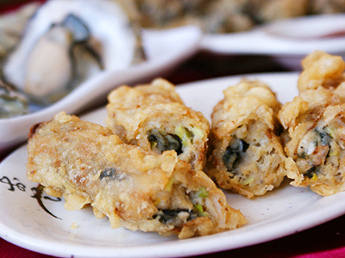
Oyster Rolls
These are oyster rolls.

Slide 8
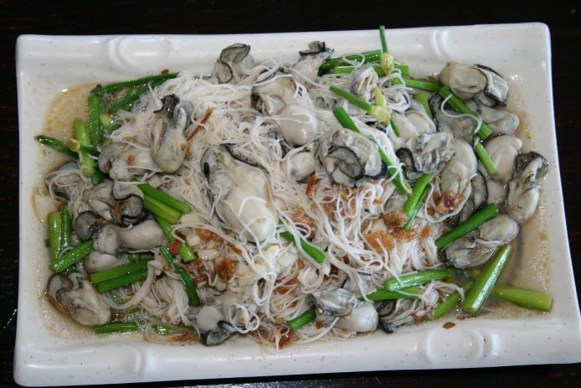
Oyster Thin Noodles
This is oyster thin noodles.

Slide 9
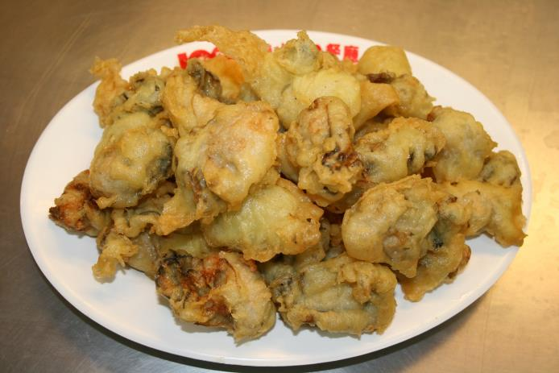
Fried Oyster
These are fried oysters.

Slide 10

oysters
beds
rolls
omelet
thin noodles
soup
fried oyster

Slide 11


May I take your order?
I would like oyster noodles and oyster soup.
Waiter
Customer

Slide 12
Here you are. Enjoy your meal.
Thank you.
Waiter
Customer

Slide 13


Slide 14


O | B | A | T | T | E | R | B | H | N
M | E | M | P | L | E | A | U | O | S
E | N | U | B | E | D | E | O | M | T
L | T | S | Y | E | N | D | P | E | R
E | B | E | I | T | L | R | B | H | O
T | U | R | P | E | R | A | U | O | L
A | F | X | S | Z | M | U | N | R | L
W | Q | O | Y | S | T | E | R | W | R
oyster
omelet
noodle
roll
bed

Slide 15


