Slide 1
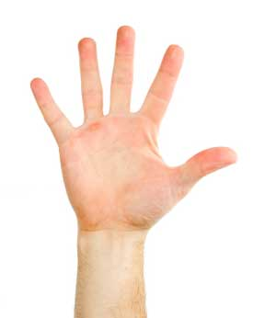

How are you today?
5 = awesome
4= happy
3= ok
2= sleepy
1 = sad
Today I feel_________.

Slide 2


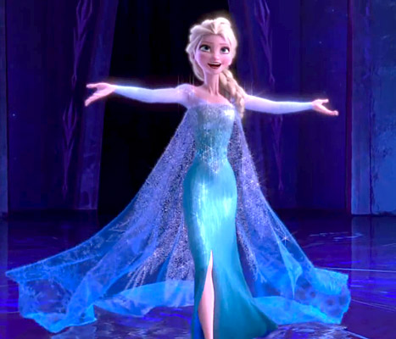
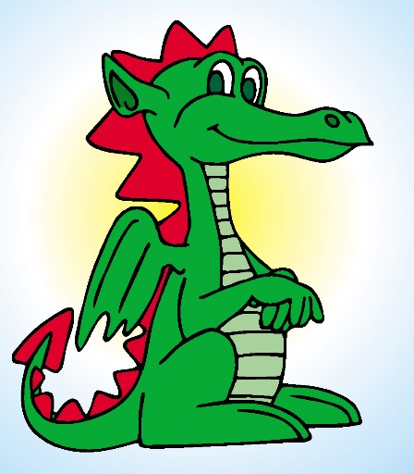
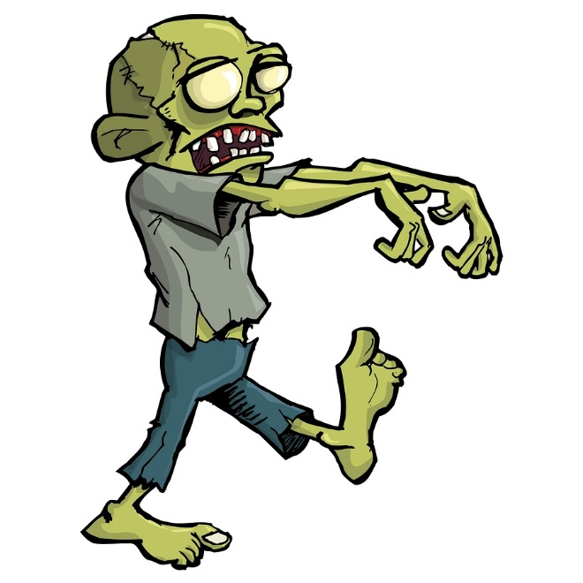
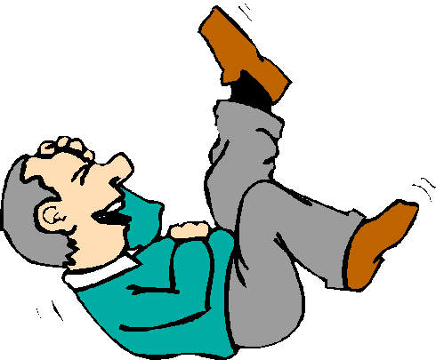
What books do you like?
I like fairy tales!
I like horror stories!
I like funny stories!

Slide 3

Let’s read a Story!

Slide 4
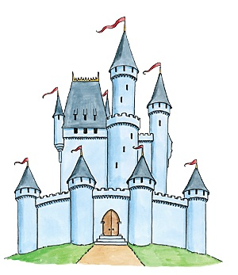
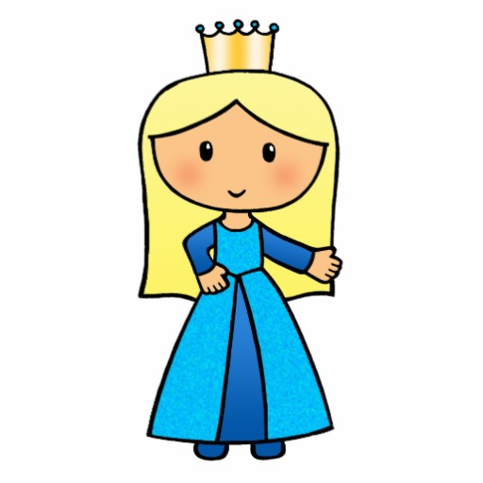

The princess and the pea.

Slide 5
Queen
Prince
Princess

Slide 6
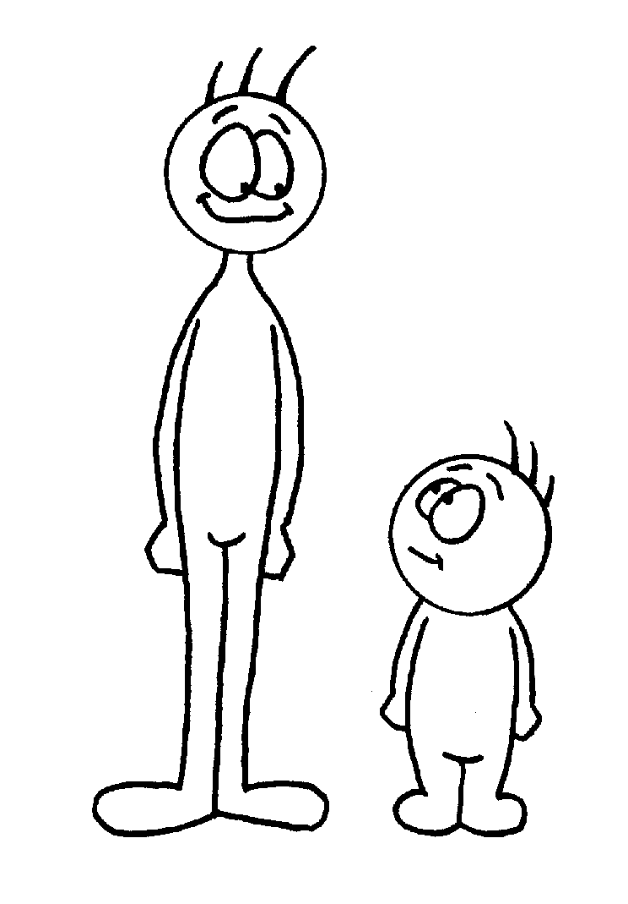
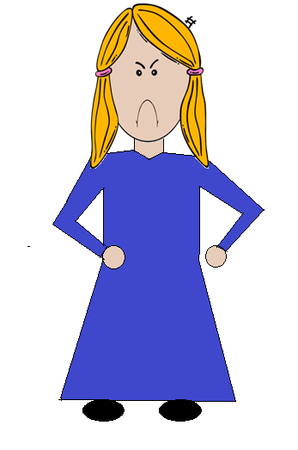
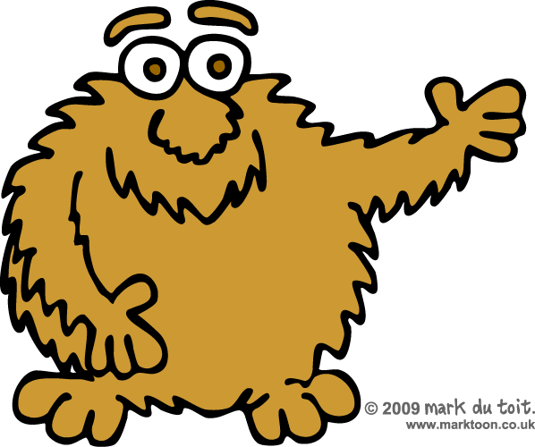
Tall
Hairy
Angry

Slide 7
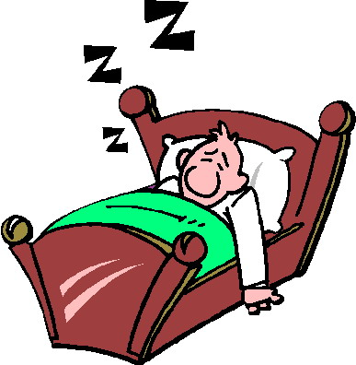
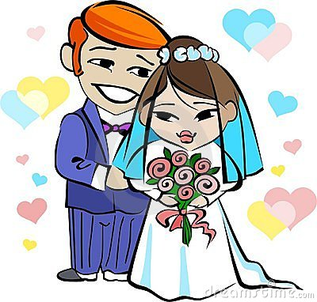
Sleep
Marry

Slide 8
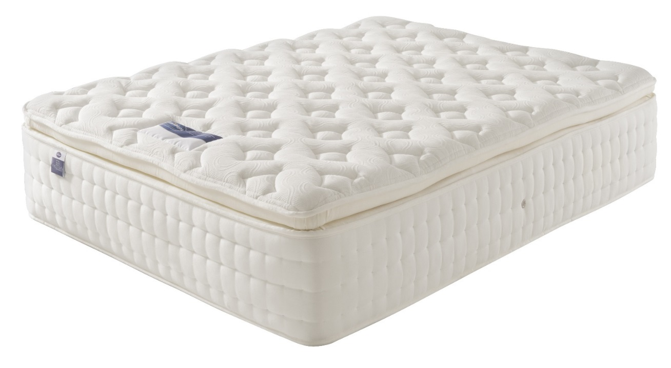
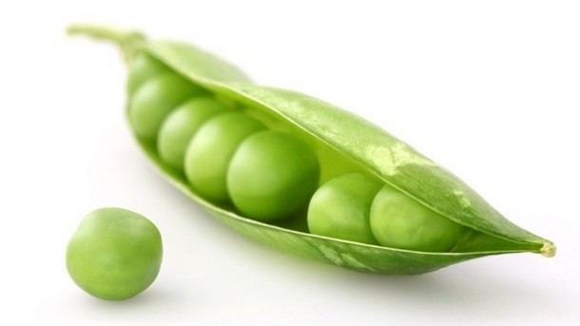
Mattress
Pea

Slide 9

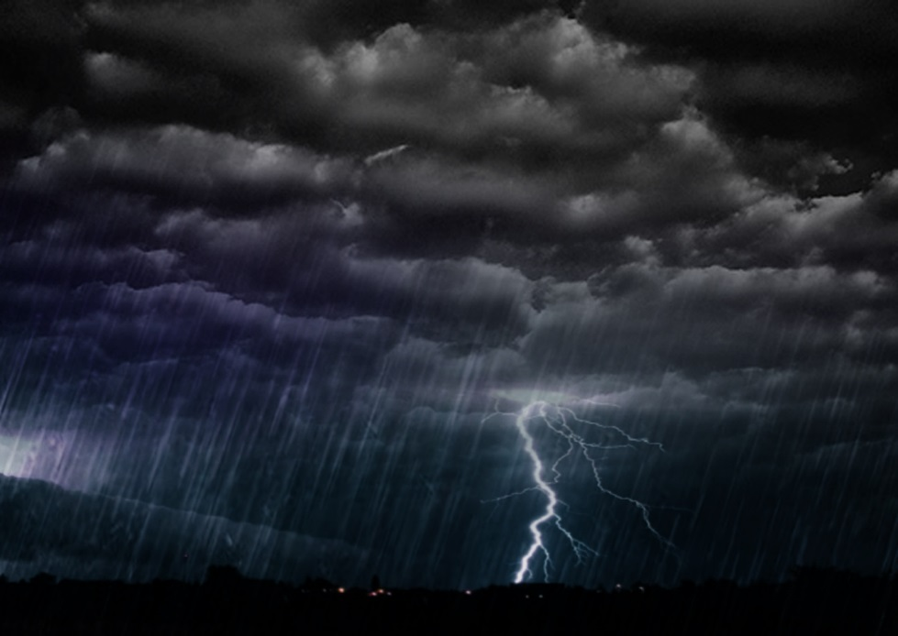
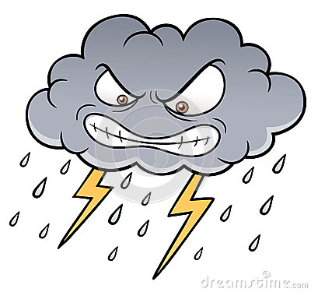
knocked
storm

Slide 10
Queen
Prince
Princess

Slide 11
Tall
Hairy
Angry

Slide 12
Sleep
Marry

Slide 13
Mattress
Pea

Slide 14
knocked
storm

Slide 15
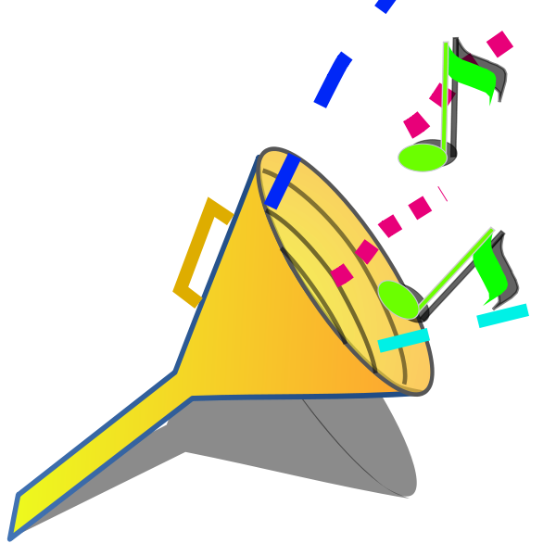
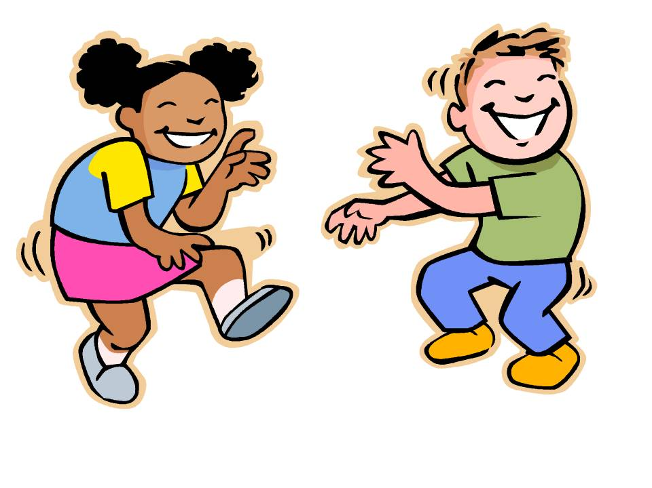
Let’s make sounds and actions!

Slide 16
Prince
Princess

Slide 17
Tall
Hairy
Angry

Slide 18
Sleep
Marry

Slide 19
Mattress
Pea

Slide 20
knocked
storm

Slide 21
Vocabulary
Prince
Princess
knocked
tall
angry
hairy
pea
mattress
storm
sleep
marry

Slide 22
The princess and the pea.

Slide 23
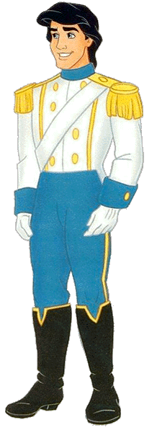
Once upon a time, there was a prince who wanted to marry a princess.
He went to find his wife.

Slide 24
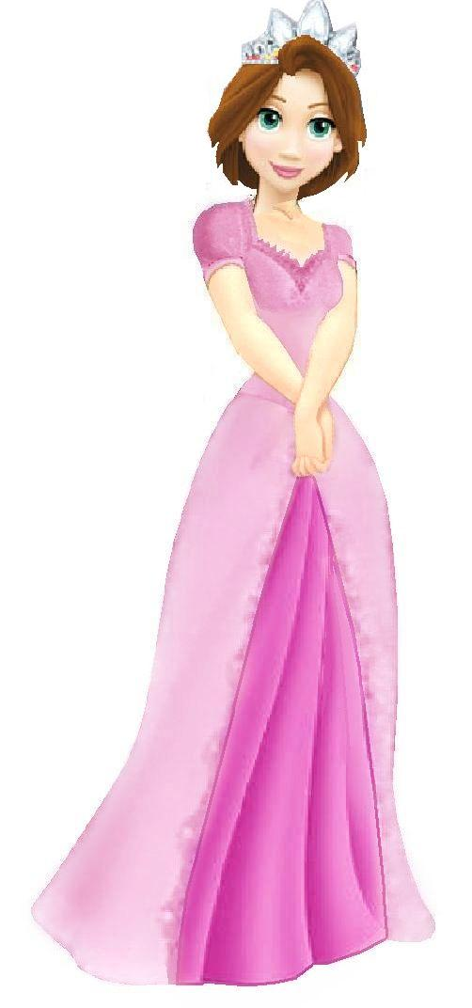
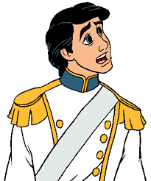
The first princess was too tall..

Slide 25
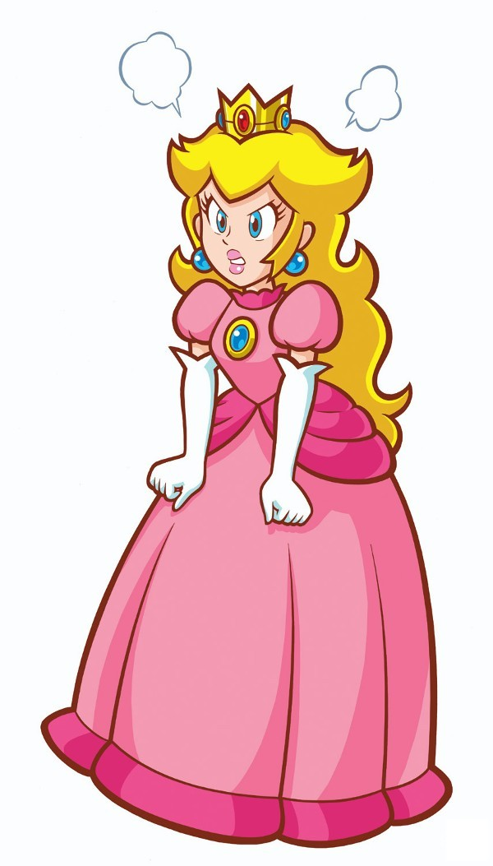
The second princess was too angry.

Slide 26
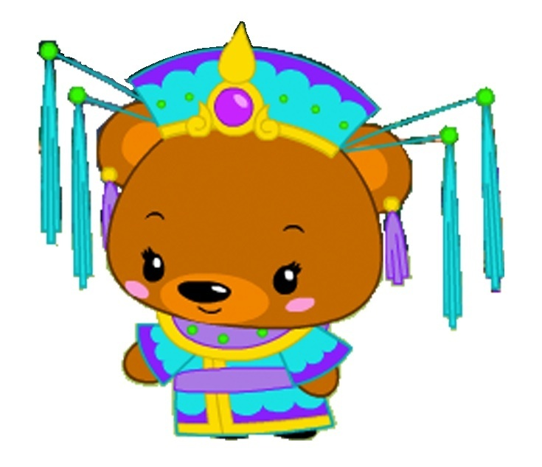
The third princess he met was too hairy!
The prince was sad and tired so he went home.

Slide 27
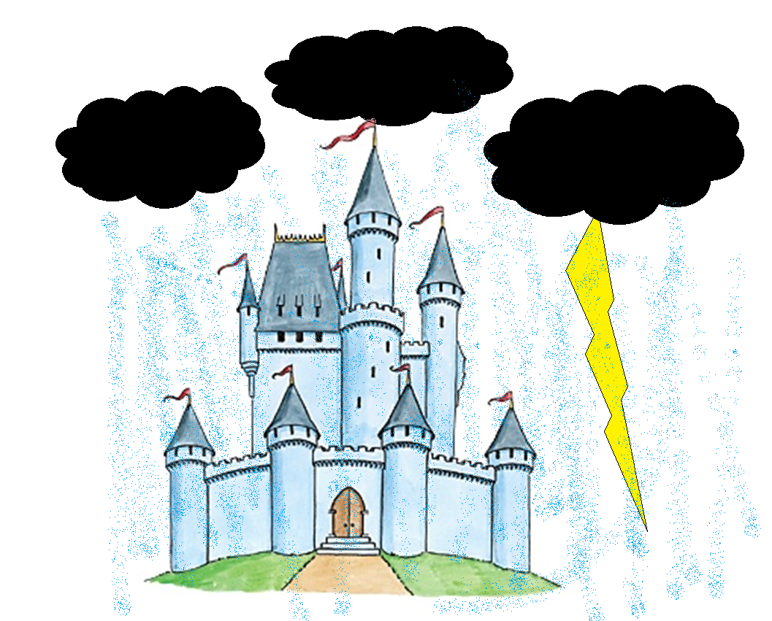

One night there was a terrible storm.

Slide 28

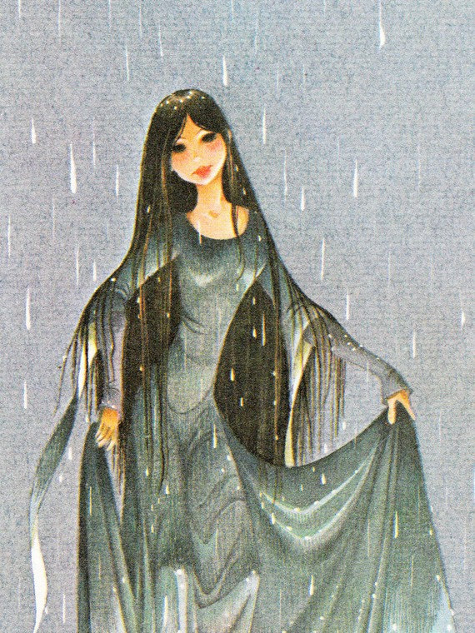
A wet girl knocked at the door.
“I am a princess.
I need to sleep.”

Slide 29
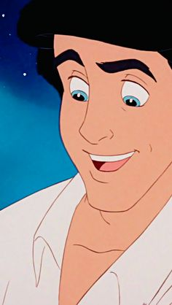


The prince fell in love when he saw her.
“I want to marry her!”

Slide 30
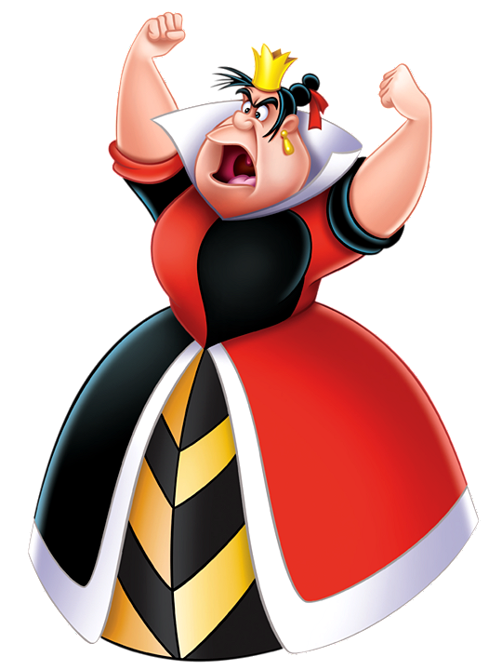
But the queen was angry.
She gave the princess a test.

Slide 31
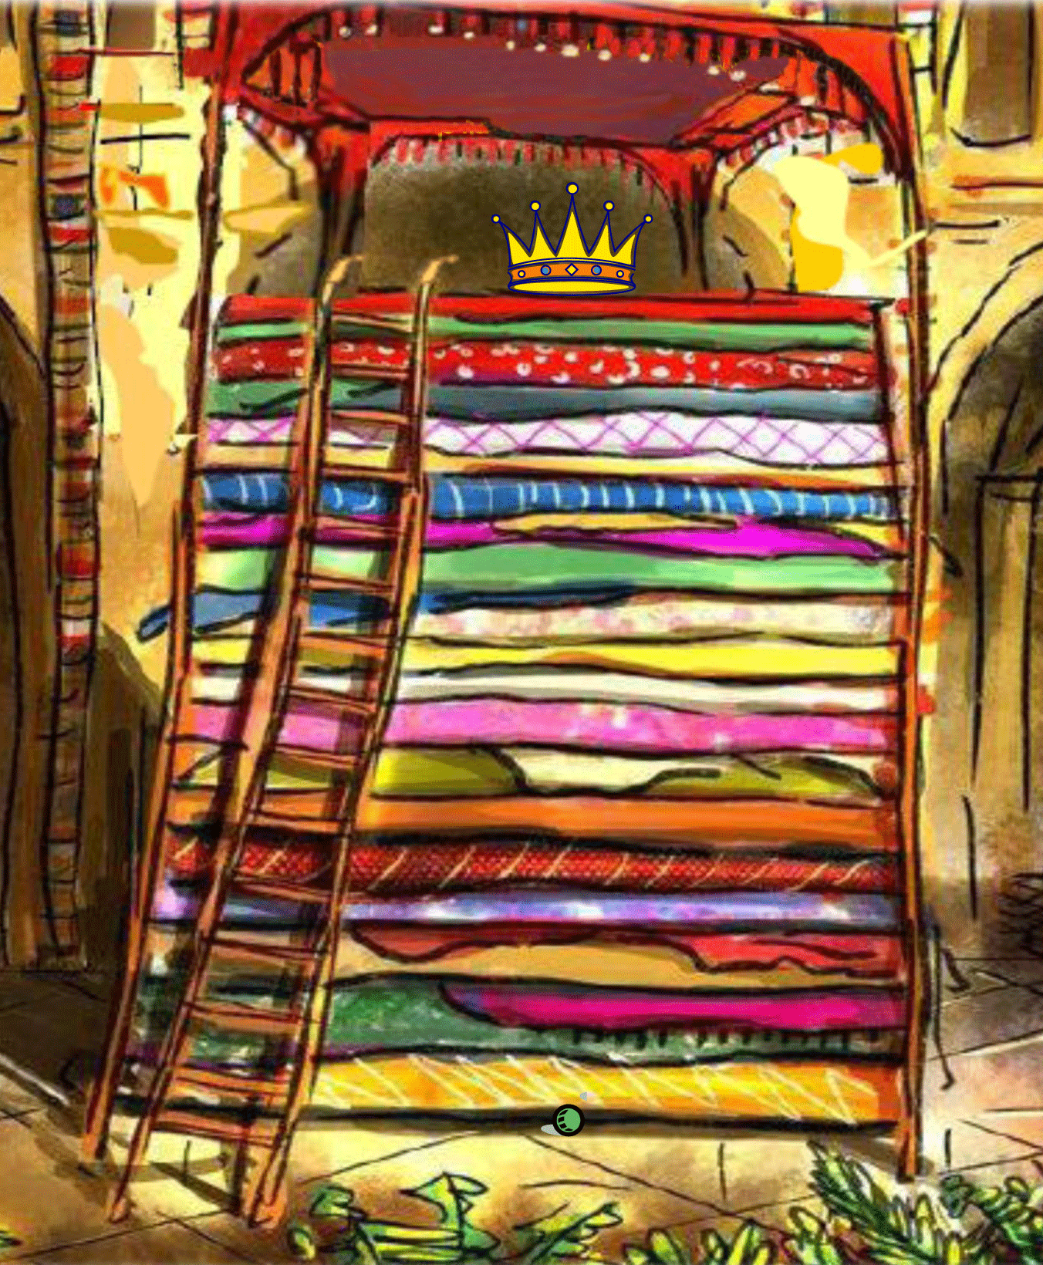
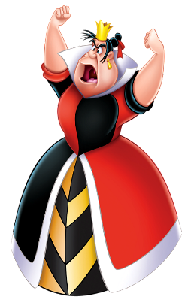
The Queen put a pea under the mattress that night.

Slide 32
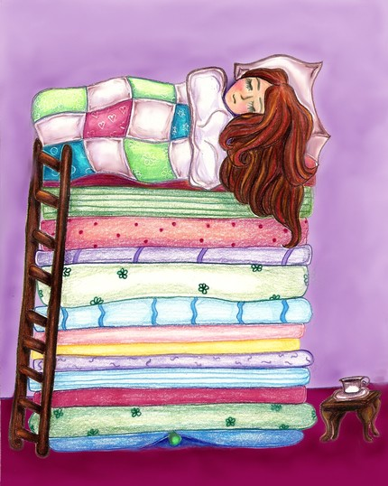
The girl could not sleep.

Slide 33
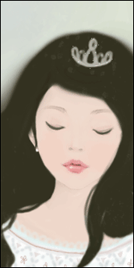

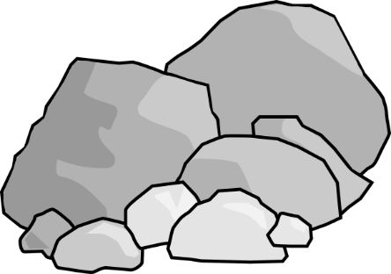
“Did you sleep?” said the queen.
“No!” said the princess.

Slide 34
The Queen was happy. The girl was a princess!
The Prince and Princess marry and live happily ever after.

Slide 35
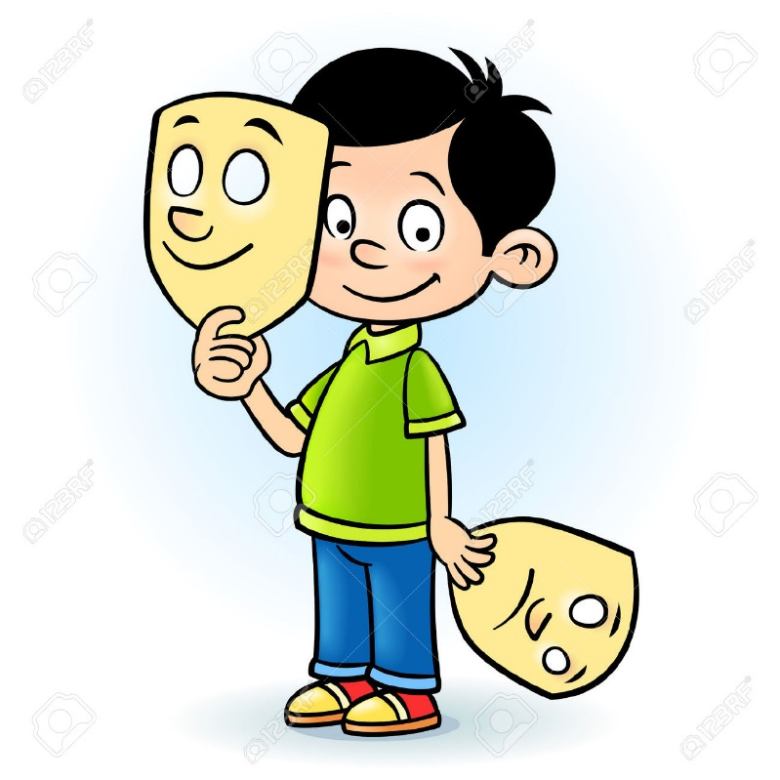
Let’s do some acting!

Slide 36
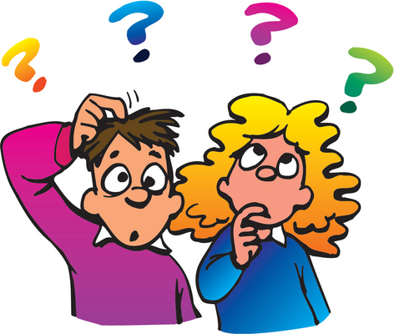
Do you remember the story?

Slide 37
The prince wanted to _____ a princess.
marry

Slide 38
This princess was too ______.
angry

Slide 39
This princess was too ______.
hairy

Slide 40
One night there was a _____.
storm

Slide 41
A girl _____ on the door.
knocked

Slide 42
prince
The _____ fell in love. He wanted to _____ her.
marry

Slide 43
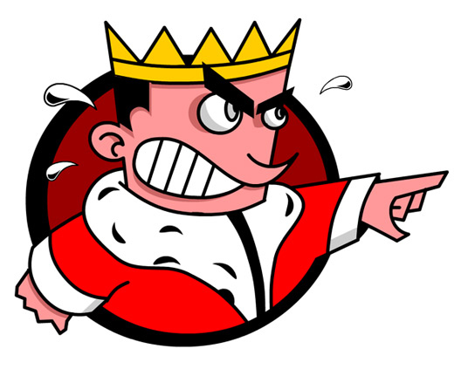
The Queen was ______.
angry

Slide 44
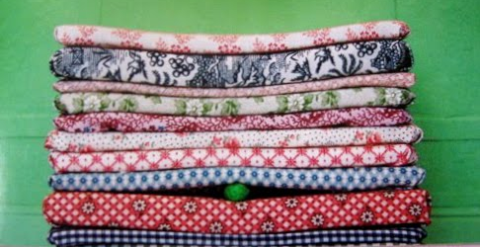
pea
She put a ____ under her ______.
mattress

Slide 45
sleep
The girl did not _____. She was a p_______.
rincess

Slide 46
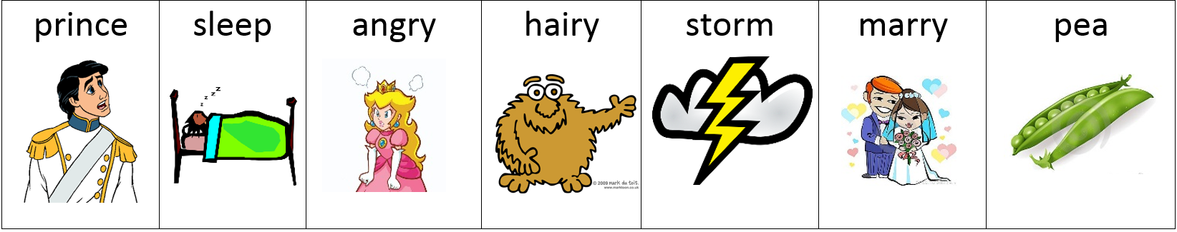
Rock, scissor, paper game.
Player 1
Player
2

