Slide 1
Self-Introduction 自我介紹
Name:
Number: thirteen

Slide 2
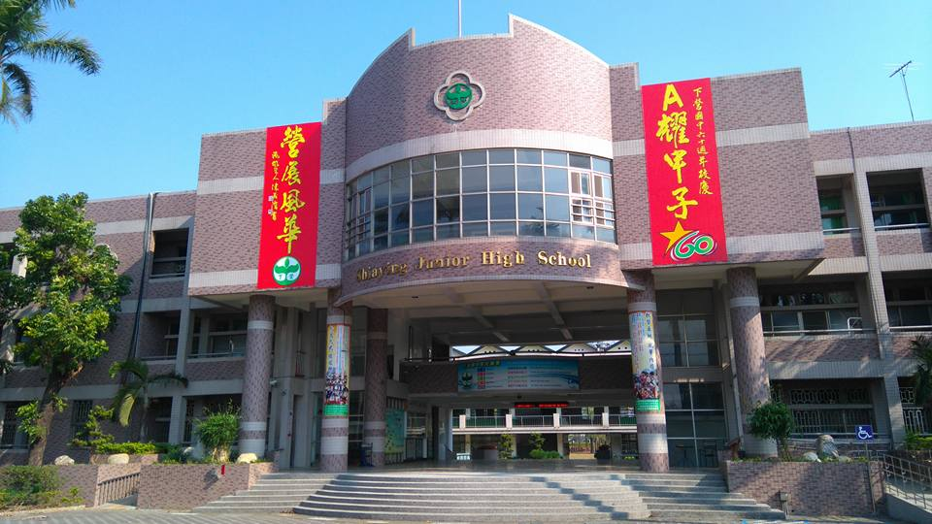
Basic Information
Good morning, everyone.
My name is Wu Yixuan .
I am fifteen years old.
I live in Siaying, Tainan.
I study in Siaying Junior High School.
I am a ninth grade student.
My class is 901.
My favorite subject is Chinese and history
because it’s interesting for me.

Slide 3
My Family
There are five people in my family
My father is a computer engineer.
He is hard-working and a considerate My mother is an accounting. She is slim and very kind to me.
My sister is a senior high school student, and she likes to watch TV in her free time.
I love them very much.

Slide 4
My Friend
I have three good friend in my school.
They are Yan Yi, Huang Yuning, Zeng Jun.
They are always there for me.
They will help me when I am down and make me feel better.
We always do everything together: no matter where we are.

Slide 5
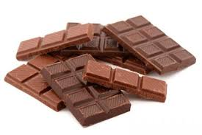
I like…
I like to eat chocolate
because they’re yummy for me.
I like to listen to relaxed music when I feel down.
I like white
because they’re special for me.
And they always give luck to me.

Slide 6
My Dream
When I was a child, I wanted to be a teacher because I could teach and help students who need help.
I want to be a traveler because you can learn a lot of languages and you can also play around the world.

