Slide 2
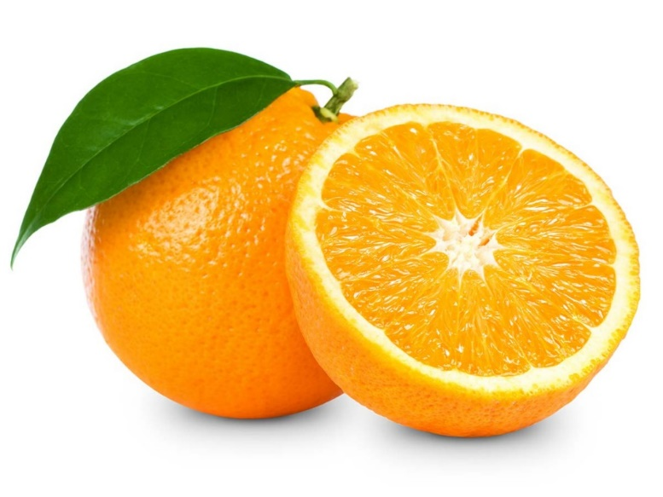
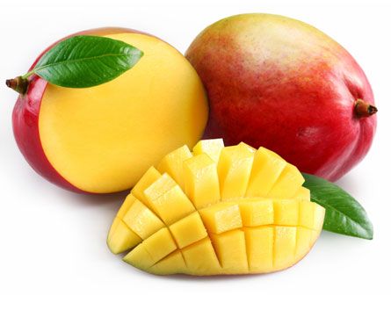
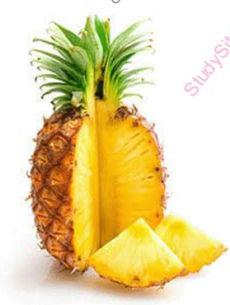
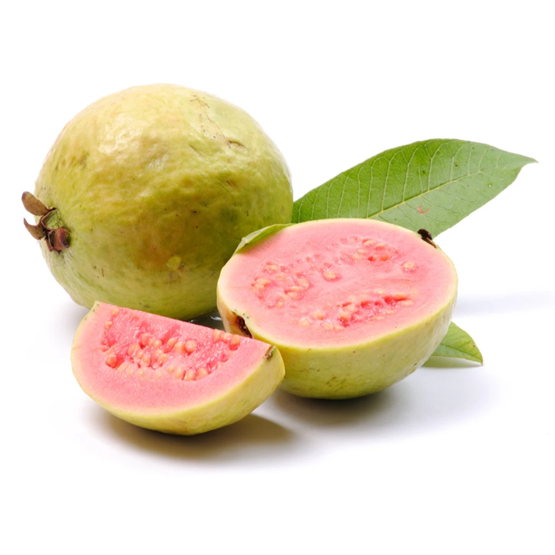
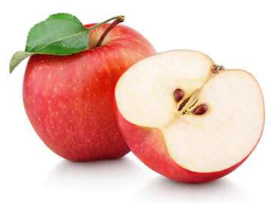
What fruit is it?

Slide 3
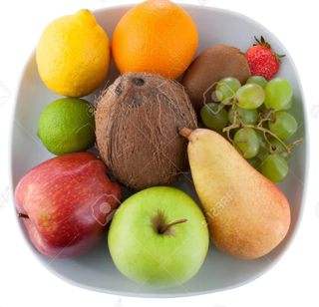
Look and Say
2.
1.

Slide 4
Color(顏色)

Slide 5
What color do you see? I see ______.
Color song
https://www.youtube.com/watch?v=7_Zzw96qJ1Y

Slide 6
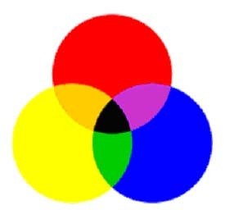
three primary colors (三原色)
Color vocabulary
https://www.youtube.com/watch?v=ybt2jhCQ3lA

Slide 7
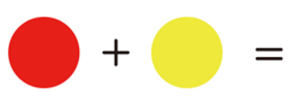
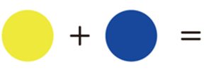
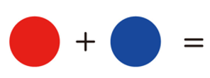
Mix colors (混合色)

Slide 8
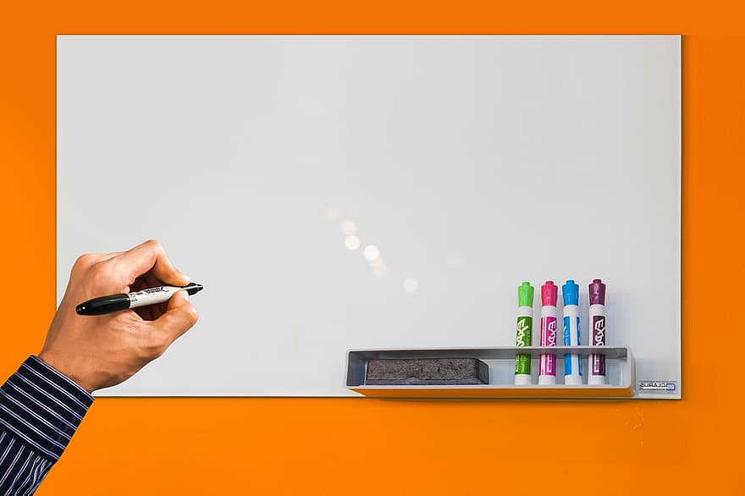
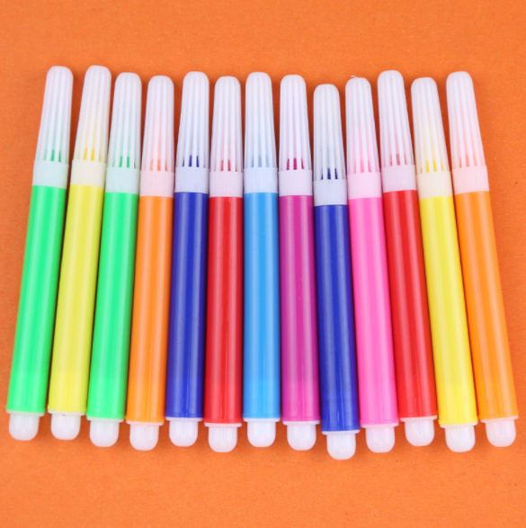

Slide 9
1. 4.
2. 5.
3. 6.

